Slide 1
A Contextual-Bandit Approach to Personalized News Article Recommendation
Lihong Li, Wei Chu, John Langford, and Robert E. Schapire. 2010.
WWW '10: Proceedings of the 19th international conference on World wide web
Group 7:
Tommy - Tongle Shen,
Zach - Chenhao Zhu,
Shirley - Keyin Wang,
Andy - Yuxuan Yang

Slide 2
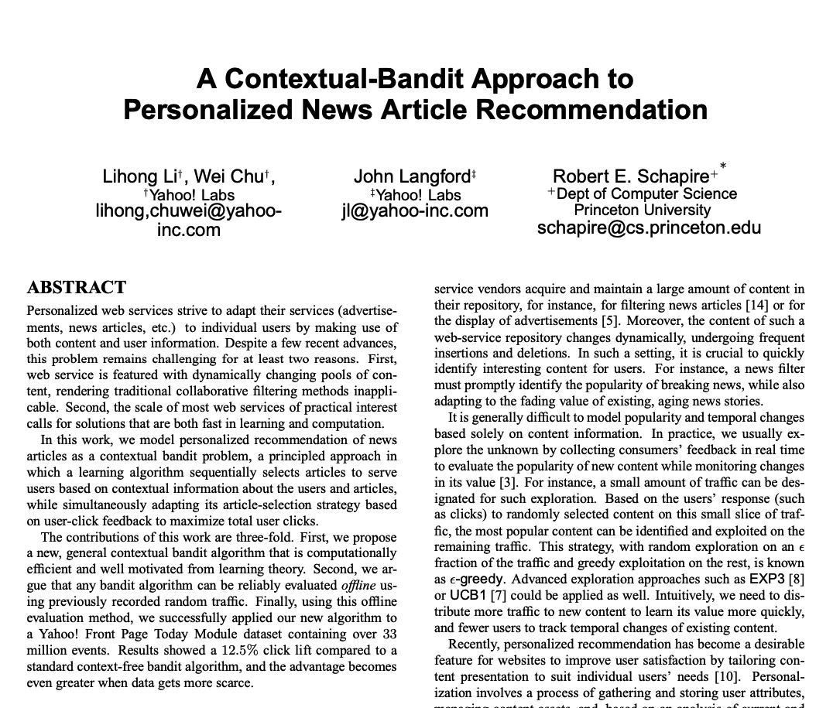
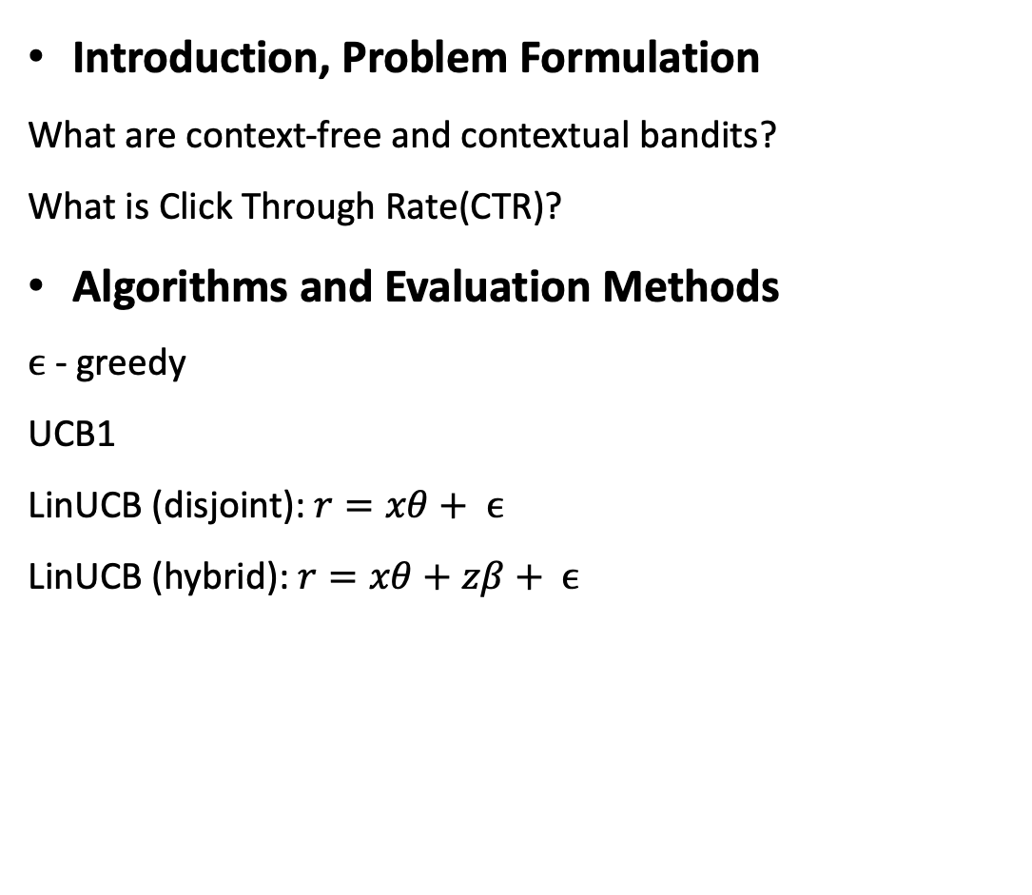
Outline
Introduction, Problem Formulation
What are context-free and contextual bandits?
What is Click Through Rate(CTR)?
Algorithms and Evaluation Methods
$ϵ$ - greedy
UCB1
LinUCB (disjoint): $r=xθ+ ϵ$
LinUCB (hybrid): $r=xθ+zβ+ ϵ$
Li, L., Chu, W., Langford, J., & Schapire, R. E. (2010). A contextual-bandit approach to personalized news article recommendation. In Proceedings of the 19th international conference on World wide web (WWW '10)

Slide 3
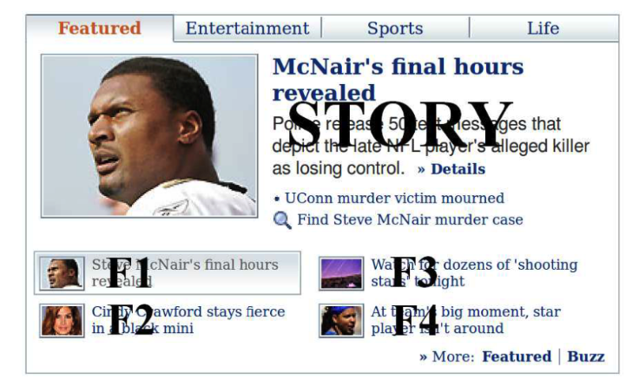
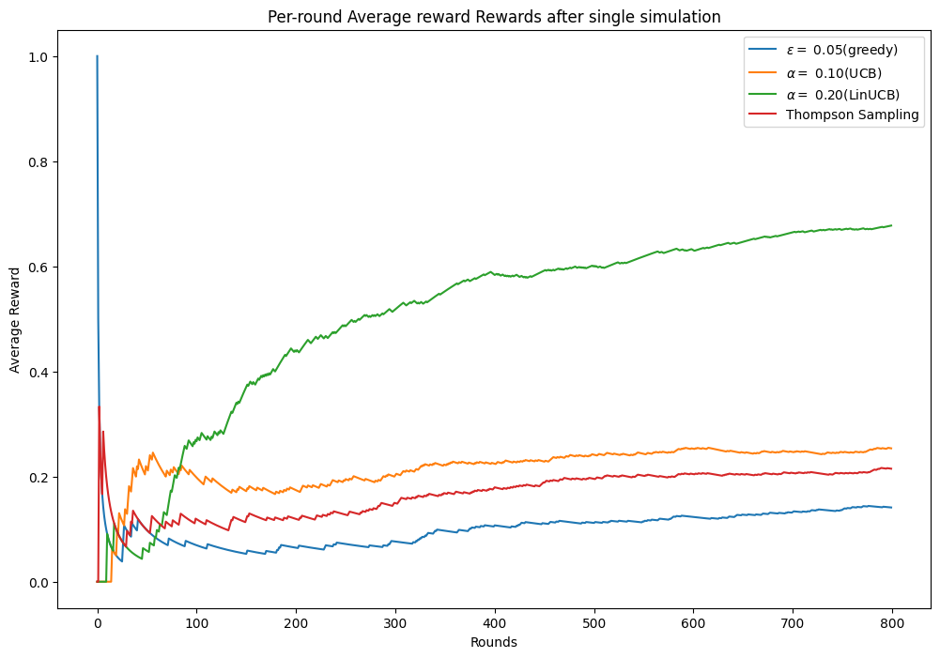
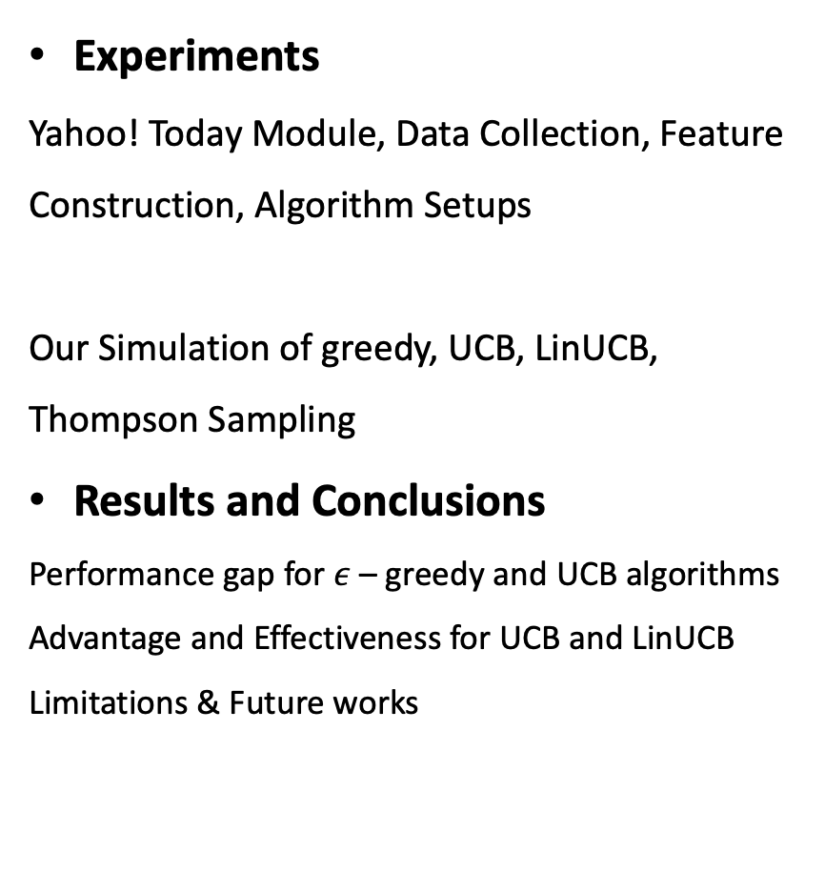
Outline
Experiments
Yahoo! Today Module, Data Collection, Feature Construction, Algorithm Setups
Our Simulation of greedy, UCB, LinUCB, Thompson Sampling
Results and Conclusions
Performance gap for $ε$ – greedy and UCB algorithms
Advantage and Effectiveness for UCB and LinUCB
Limitations & Future works
Li, L., Chu, W., Langford, J., & Schapire, R. E. (2010). A contextual-bandit approach to personalized news article recommendation. In Proceedings of the 19th international conference on World wide web (WWW '10)

